Slide 1

Medical Murder is the #1 Cause of Death in the U.S. – By Design (People Are Too Expensive – Satan’s Big Lie)
How? The American Dream

Slide 2
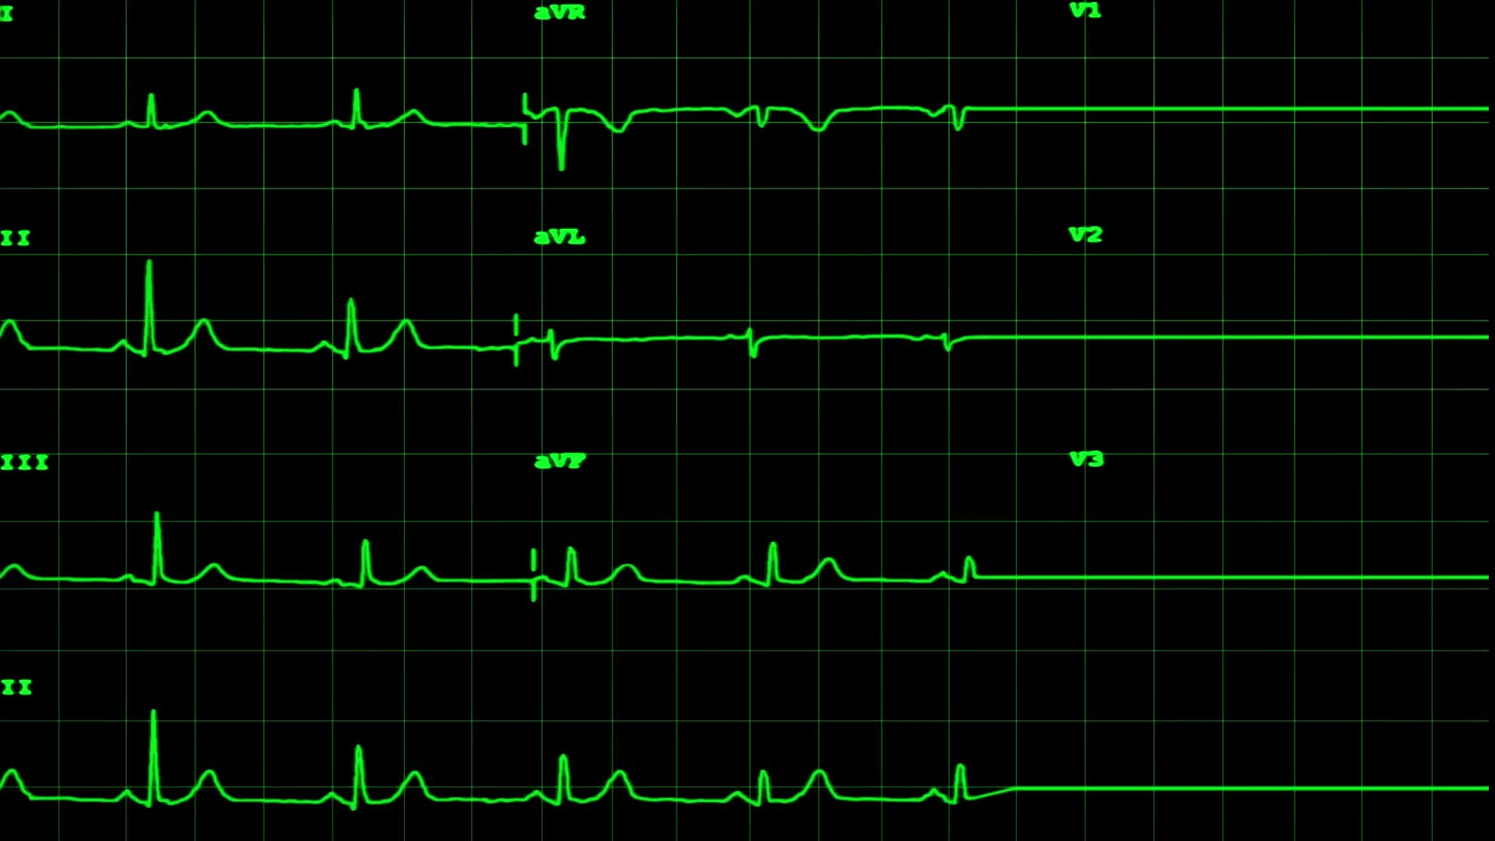
Facts:
Historical facts – pre-COVID
Annual deaths: 700K heart disease; 600K cancer; 400K medical “malpractice” (3rd leading cause of death)
https://www.statnews.com/2021/08/04/medical-errors-accidents-ongoing-preventable-health-threat/#:~:text=Injury%20or%20illness%20caused%20by,under%20wraps%20%E2%80%94%20and%20they%20are
Current facts – COVID Era and Post COVID
All cause mortality increase of 24% in vaccinated
https://www.israelnationalnews.com/news/317091
All cause mortality cumulative increase since January 2020 – weekly graph
https://ourworldindata.org/grapher/cumulative-excess-mortality-p-scores-projected-baseline?tab=chart&facet=none&country=~USA

Slide 3


The setup – the anti-Christ system (review)

Slide 4



God gave us a free will… we default to selfishness without Him
What was the first recorded sin of man? Eve wanting her own way. The deception – you can be like God by pursing knowledge.
While we pursue knowledge, all kinds of evil is taking place – How is that possible? Because the knowledge we are led to believe is actually lies, disguised as truth: A barrier to the truth is believing you already have it!

Slide 5
Conclusion: The anti-Christ system is the perfect solution to our desire to get ahead in this world.

Slide 6

Fast forward to recent American history

Slide 7

Like a magician, Satan preys on our selfishness and created a delusion, called ‘The American Dream’ to keep us chasing an illusion (we can have it all), while his real agenda was hidden in plain sight.

Slide 8

Wanting our own way has us believing in all kinds of lies because we’ve put our trust in men, as a result of wanting our own way. The American Dream preys on our selfish nature. Why do I know? This is what I chased most of my life.

Slide 9
Like what?
God gave us a warning, as He always does: Jeremiah 17:4 – 5 (in part): Through your own fault you will lose the inheritance I gave you. I will enslave you to your enemies in a land you do not know; Cursed is the one who trusts in man, who draws strength from mere flesh and whose heart turns away from the Lord.
Is God against our plans? No, Proverbs 16:9 A man’s heart plans his way, but the Lord determines his steps. Same as He is not against knowledge Hosea 4:6. He’s against our plans and quest for knowledge replacing Him.
Major American PSYOPs (when you think of these things, remember at least 70% of the country thinks you are wearing a tinfoil hat for believing the truth) – Kennedy assassination, 9/11 false flag, COVID – all child’s play compared to…
The American Dream (home of the free and land of the brave); The American Dream doesn’t need God – He is an afterthought; it was all a trap to deceive, preying on our selfishness, as you’ll soon find out.

Slide 10

What is the American Dream?
2.1 children 1.7 dogs (no cats), work hard, save money, retire early and relax, live a clean life, obeying laws and paying taxes, free health care at 65 - Where’s God? Same choice as in the garden. We can have it all, at the expense of God (who needs Him if you have everything), or have God and give up our ‘right’ to our own way.
How did this happen? By design…

Slide 11
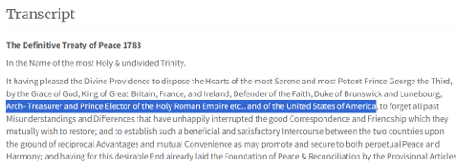
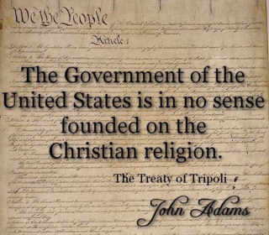
By chasing the American dream, we’ve been deceived
What is the truth about our country?
Paris Peace Treaty of 1783 ends the Revolutionary War
How did we get here?
1797 Treaty of Tripoli

Slide 12
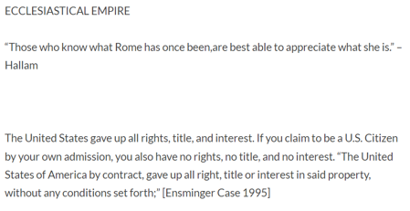
It is written in "The Elements of Ecclesiastical Law", no law exists in US without the pope's approval
The United States gave up all rights, title, and interest. If you claim to be a U.S. Citizen by your own admission, you also have no rights, no title, and no interest.
“The United States of America by contract, gave up all right, title or interest in said property, without any conditions set forth;” [Ensminger Case 1995: “This action was instigated to determine who has the highest title to property located in [Major and Grady] county, Oklahoma Territory state, of which the United States of America by contract, gave up all right, title or interest in said property, without any conditions set forth.”

Slide 13
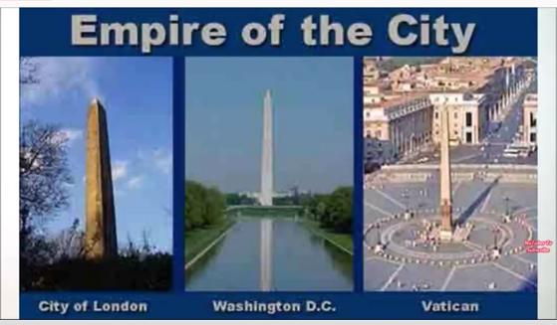
“Voluntary” consent in the ‘land of the fee and home of the slave’ is an illusion… https://www.bitchute.com/video/s8LQZElrHtMl/
A coincidence that all three “cities” have a satanic monument?

Slide 14
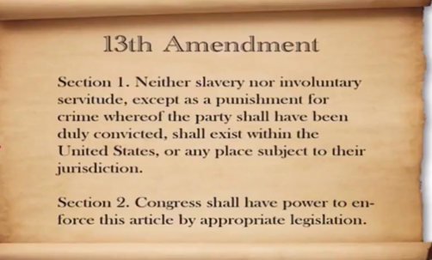
We can’t be involuntary slaves!
The 14th Amendment made us all U.S. Citizens, so next they bankrupted the country, making us and our property collateral for the debt.
James Traficant speech to Congress March 17, 1993:
https://youtu.be/AO4n0eqSx84
Then they got us to comply with the scam voluntarily - birth certificate; use their fake currency; pay taxes; use their legal system. We became slaves.

Slide 15
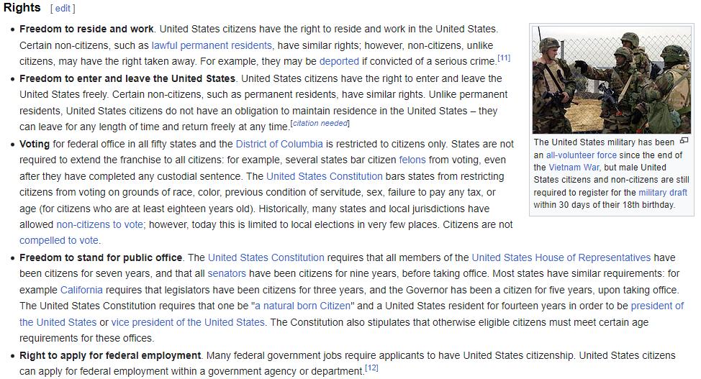
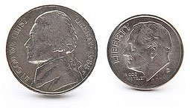
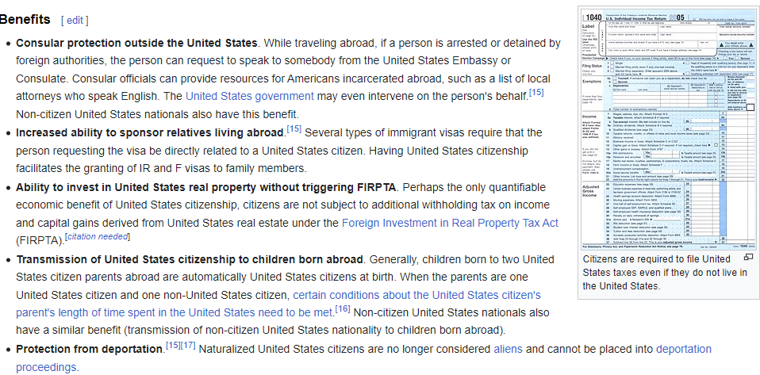
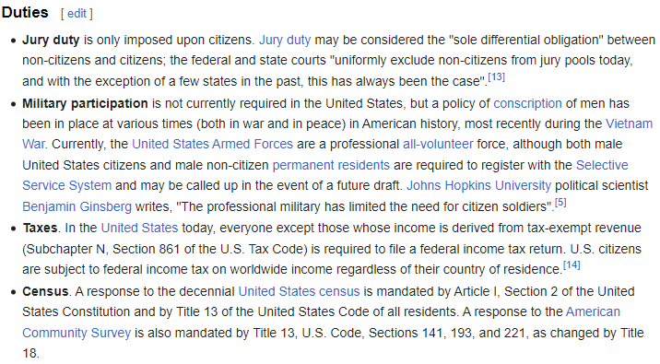
What did we get in trade?

Slide 16
Conclusion: We’ve been lied to. The U.S. is a bankrupt corporation. When we claim to be citizens of the U.S., we give up all rights to self and property. Our pursuit of The American Dream resulted in slavery.
We don’t have to remain deceived. From ‘Fallen Angels are in Control of American’:
https://youtu.be/GuPZ5nAFjVc?si=7i4r9jkskB_LFJEZ

Slide 17


We’re being played in the ultimate esoteric Hegelian Dialectic
Planet YES! People NO!

Slide 18
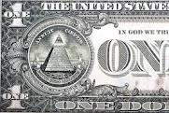
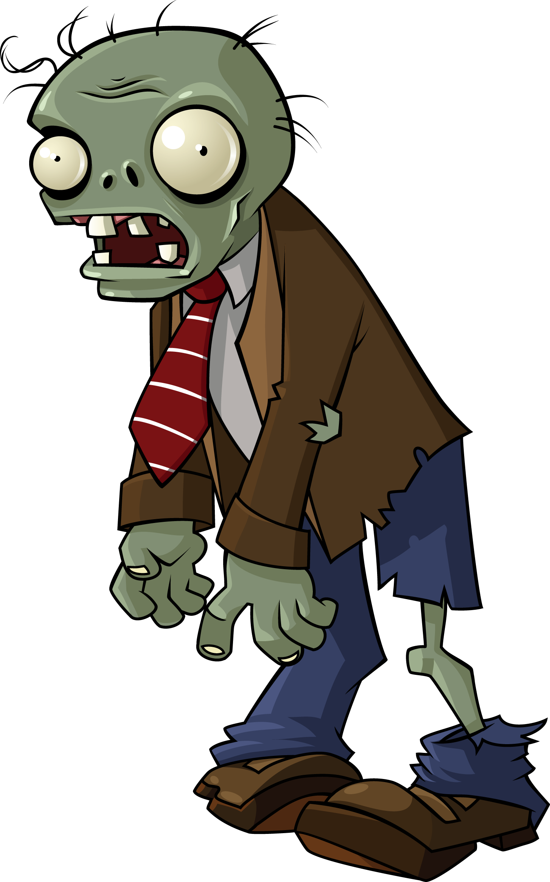
The end game: Zombies Pursue Fake Money
How can the State afford to carry out this trade? Fake money; the Globalists have all the real money!
https://youtu.be/pENxsLVR_Xs?feature=shared
Once God is out of the picture, the State steps in; the State works for the Globalists and the Globalists work for Satan, essentially creating zombie-like slaves – even a genius can see it…
https://rumble.com/v3lgakw-is-mass-formation-whats-behind-the-covid-psyop.html

Slide 19
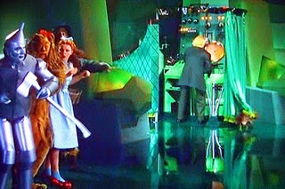

We have voluntarily submitted to the anti-Christ system believing the false prophet system would protect us – the ultimate replacement of God – NO MORE! Know the enemy. https://youtu.be/GuPZ5nAFjVc?si=7i4r9jkskB_LFJEZ
Satan’s tacit approval method
Satan exposes the evil, not only for our approval, but to keep us from looking at the real agenda – the seemingly lesser lie, but the more deceptive lie – as discussed in Parts 4 and 5 on dialectics – he was the first to employ propaganda and was the first magician
What weapons does Satan use to deceive?
https://youtu.be/26efgURWz0E?si=djzpwkVmD6k6ocID
Coach Dave – lies, deception, and fear, oh my

Slide 20


It is easier to fool someone than convince them that they have been fooled – Mark Twain
While we fool ourselves trying to be like God; He gave us the answer before we would listen:
Philippians 2:5-7: Have this mind among yourselves, which is yours in Christ Jesus, who, though He was in the form of God, did not count equality with God a thing to be grasped, but emptied himself, by taking the form of a servant, being born in the likeness of men – Jesus showed our defense is by submitting to the Father

Slide 21
Conclusion: The entire beast system is designed to capture souls, with temptations that result in bondage. Satan created an elaborate system, filled with temptations and bondage, so we conclude: “God cannot be trusted.” Exodus 6:6 – 9: “Therefore, say to the Israelites: ‘I am the Lord, and I will bring you out from under the yoke of the Egyptians. I will free you from being slaves to them, and I will redeem you with an outstretched arm and with mighty acts of judgment. I will take you as my own people, and I will be your God. Then you will know that I am the Lord your God, who brought you out from under the yoke of the Egyptians. And I will bring you to the land I swore with uplifted hand to give to Abraham, to Isaac and to Jacob. I will give it to you as a possession. I am the Lord.’” Moses reported this to the Israelites, but they did not listen to him because of their discouragement and harsh labor.
What is going on? If we know who we are, and the power we have, we will stop Satan in his tracks, just like Jesus did: https://youtu.be/FV-2zZa8MuA?si=-cSWMNl5w3S2sx9n
This is why this series is called: Medical Murder is the #1 Cause of Death in the U.S. – BY DESIGN!

Slide 22

Practical traps - other tools preying on our lack of pursuit of real knowledge/wisdom

Slide 23

Review…Satan’s use of government puppets
Projecting sin – discussed in Where: Mystery Babylon segment
Legalized propaganda - Dore question clip with propaganda
https://twitter.com/jimmy_dore/status/1659970003557572610
Use of dialectics in all four areas – covered in When: What began in the garden… segment

Slide 24

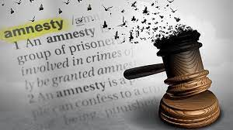
More tricks in the playbook
Promoting democracy preys on laziness – “if its free it’s for me” – democracy is what they want!
This clip has it all: democracy, less evil politician, sucking us into the free speech dialectic
https://youtube.com/shorts/lkJxO3rjlSA?si=xdKUtzho-B0UxGuf
Amnesty play shows levels of propaganda – current amnesty play “we made a mistake” – only 5% of the batches were bad!
https://www.youtube.com/watch?v=rG38_53SEbU

Slide 25
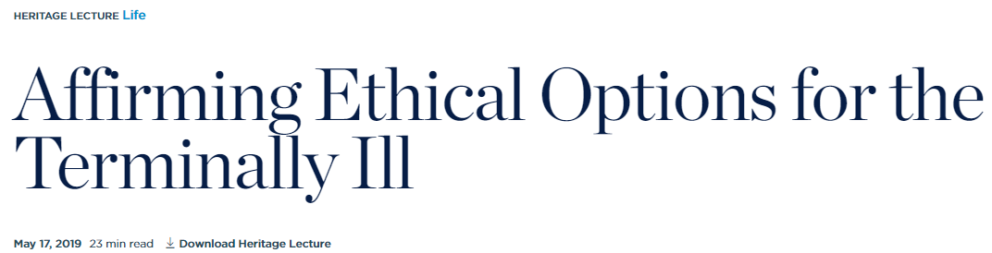

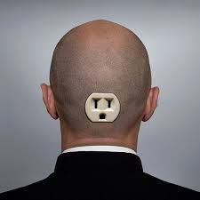
Even more…
Normalizing behavior – child heart attacks; SADS
“The normalization of medical killing poses a threat to the poor, disabled, and other vulnerable members of society.”
Get Hollywood involved
Desensitize us through predictive programming
https://gregreese.substack.com/p/predictive-programming-and-the-ohio?utm_source=substack&utm_medium=email#play
An example – smart mark
https://www.youtube.com/watch?v=i0bpK9284Sk

Slide 26

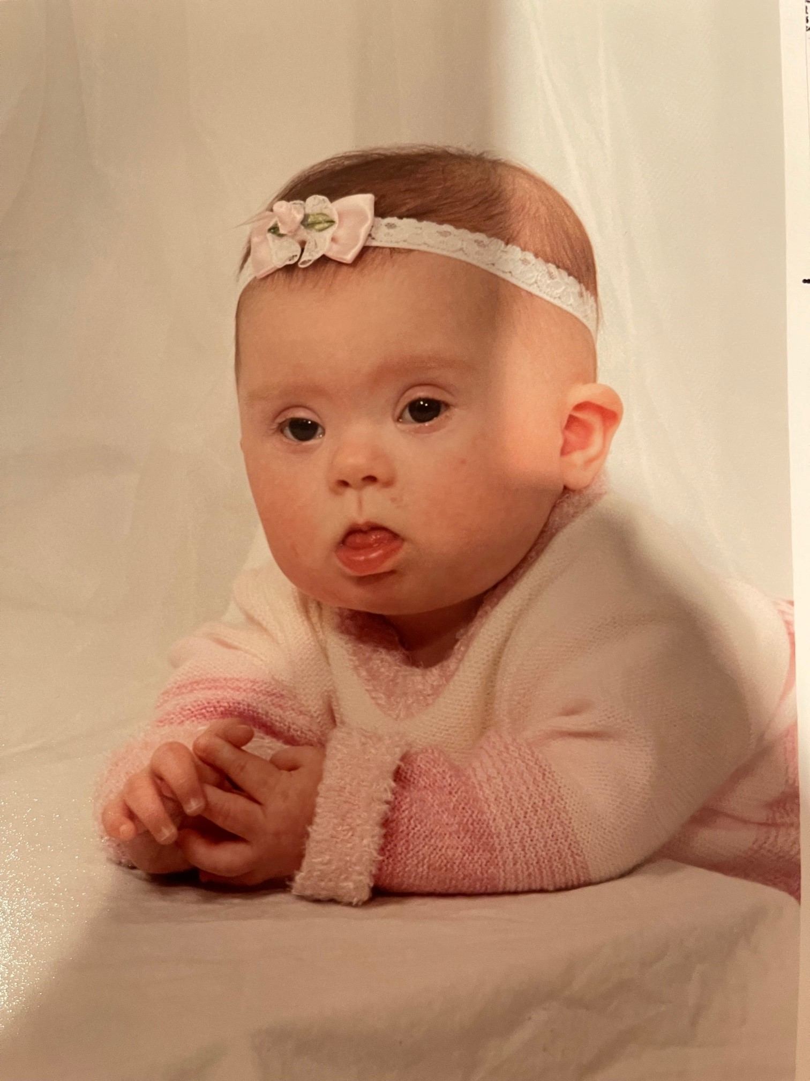
The result: People have become accomplices by trusting the medical profession
The son who takes his mom to a nursing home thinks he is doing good
The mom who aborts her disabled daughter thinks she is doing good
https://www.brighteon.com/292311eb-e23b-4537-80be-b7064f48b26d
We accept the narrative, one small step at a time…
This program contains outdated cultural depictions. Viewer discretion advised:

Slide 27
Conclusion: We’ve been programmed from every angle and have accepted the anti-Christ system one small step at a time, replacing God. The pursuit of The American Dream blinds us to reality.

Slide 28

We’ve been programmed to believe lies – from all sides and angles

Slide 29
Medical Murder is the #1 Cause of Death in the U.S. – By Design (People Are Too Expensive – Satan’s Big Lie) Up Next…
Now What: Repent, Get Right with God, and Shine the Light You Have

